Slide 1
Hash_Functions
Brian Bao Hoang

Slide 2
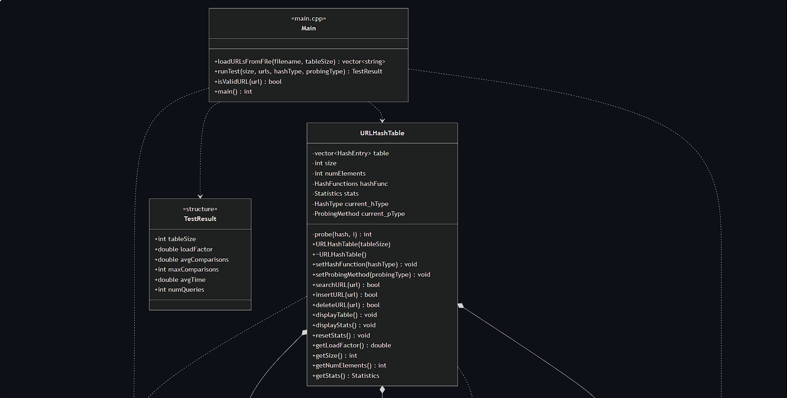
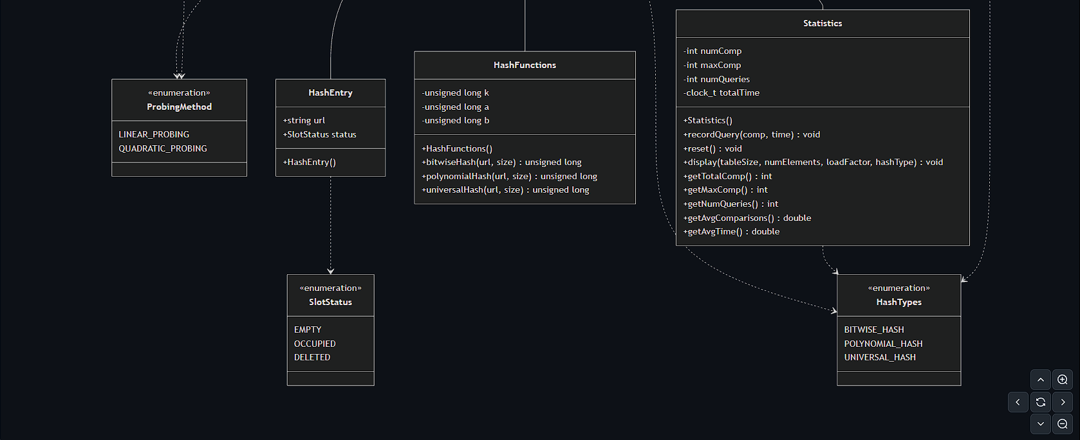
UML Diagram

Slide 3


Hash Functions Tested
Bitwise Hashing
Polynomial Rolling Hash
Universal Hashing
Scrambles bits using XOR operations
Randomizes hash function at runtime
Treats URL as base-31 number

Slide 4
Collision Resolutions
Linear Probing
Quadratic Probing
Better cache locality
Simple implementation
Primary clustering at high loads
Reduced clustering effects
Consistent performance across loads
Better worst-case guarantees

Slide 5


Performance Metrics
Data Collections
All data were collected during insertion operations
Each URL query checks for existence before insertion.
1
2
3
Average Number of Comparisons per Query
Maximum Comparisons per Query
Average Execution Time per Query

Slide 6
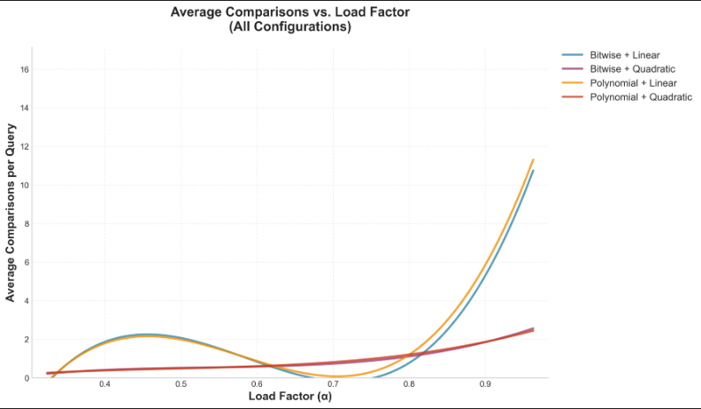
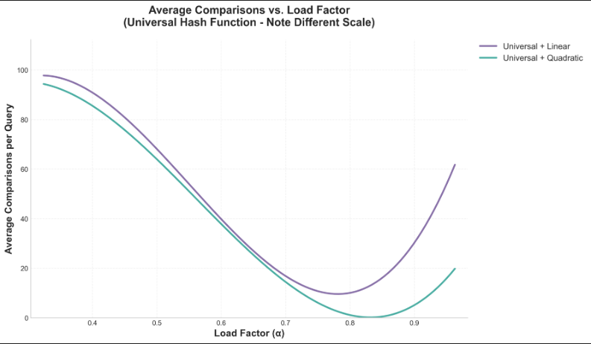
Average graphs
Key Findings
Medium loads: Quadratic better than Linear
High loads: Linear degrades significantly

Slide 7
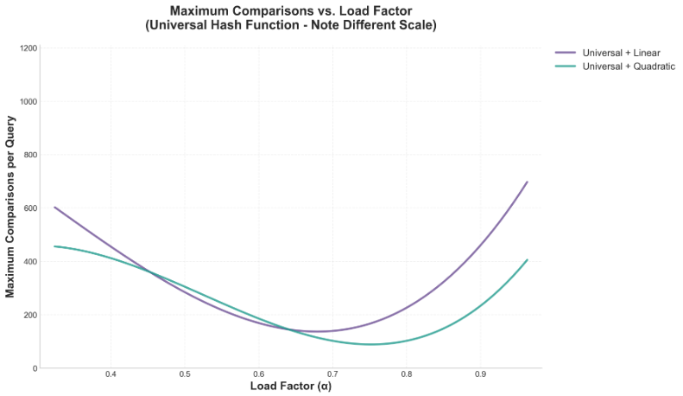
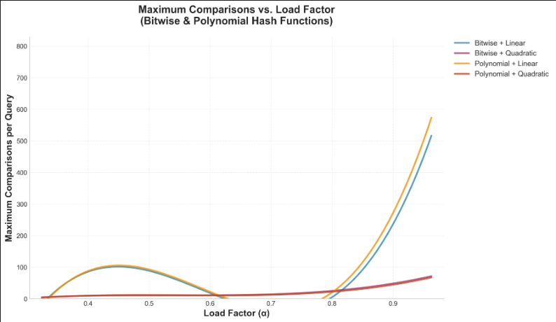
Maximum graphs
Key Findings
Linear Probing Worst Case at α = 0.96
Quadratic provides better worst-case at the same α

Slide 8
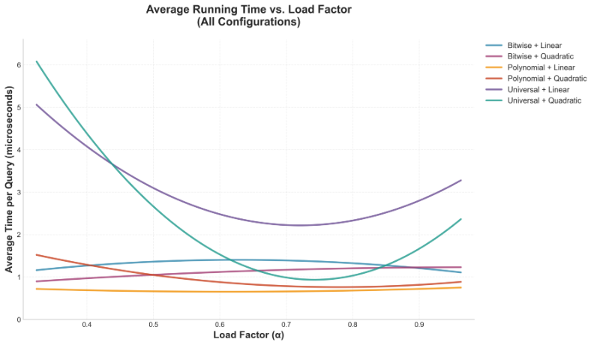
Execution Time
Key Findings
Best Case: 0.96-1.91 microseconds
String comparison cost beats hash computation cost

Slide 9
Best Performers based on α = 0.78
Bitwise + Quadratic Probing
1st
Average Comparisons: 1.06 per query
Maximum Comparisons: 22 per query
Polynomial Rolling + Quadratic Probing
2nd
Average Comparisons: 1.17 per query
Maximum Comparisons: 22 per query
Bitwise + Linear Probing
3rd
Average Comparisons: 1.63 per query
Maximum Comparisons: 49 per query

Slide 10
Comparisons
Bitwise
Polynomial
Universal
Use for Production
Best Speed
Very Good Distribution
Use for General Use
2nd Best speed
Good Distribution
Use for Theory Testing
Worst Speed
Best Distribution

Slide 11




Load Factor Impact
Green Zone
Optimal Zone
α < 0.6
Minimal performance differences
0.6 < α < 0.78
Quadratic probing strongly recommended
Yellow Zone
Red Zone
α > 0.78
Performance degradation begins
α > 0.9
Unacceptable for production
Randomizes hash function at runtime

Slide 12
Conclusion
Project Summary
1
Comprehensive testing of 60 configurations
Clear winner: Bitwise Mixing + Quadratic Probing at α ≈ 0.70
Achieves <2 avg and <60 max comparisons per query
Real-World Impact
Sub-microsecond query performance
Predictable worst-case behavior
Scalable solution for browser URL caching
2
Key Factors
3
Probing method (2-10x impact) > Hash function (5-10% impact)
Focus engineering effort on load factor management

Slide 13
Questions?
Email:
baovan@asu.edu
Github Link: https://github.com/baoblank25/Hash_Function_Benchmark

Slide 14
Thank You!

